Slide 1
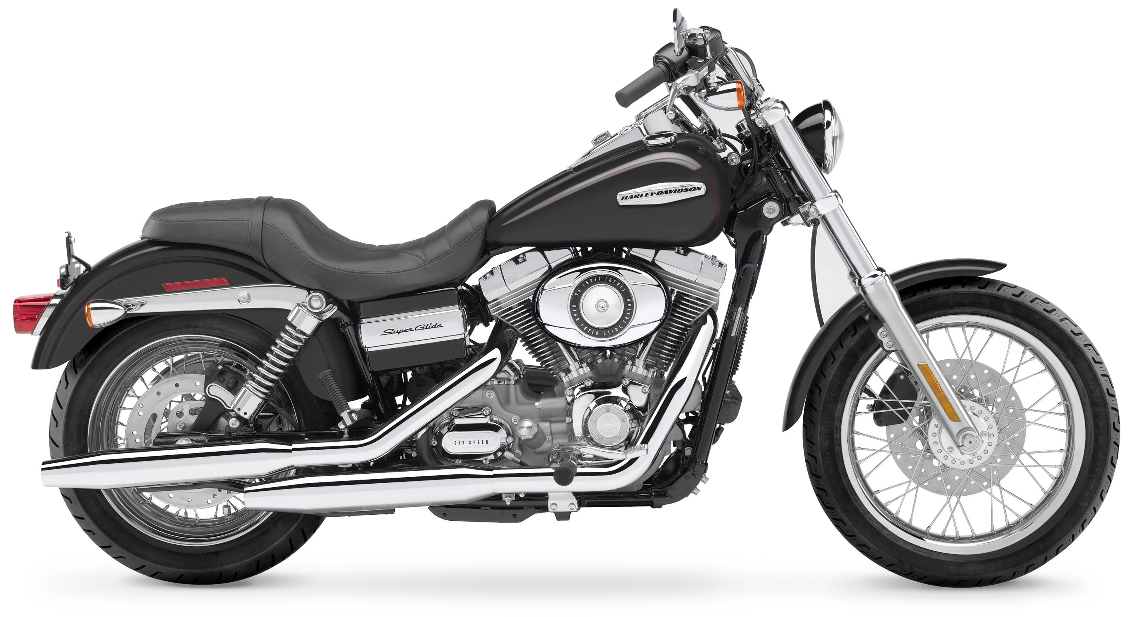
SMART RIDE

Slide 2
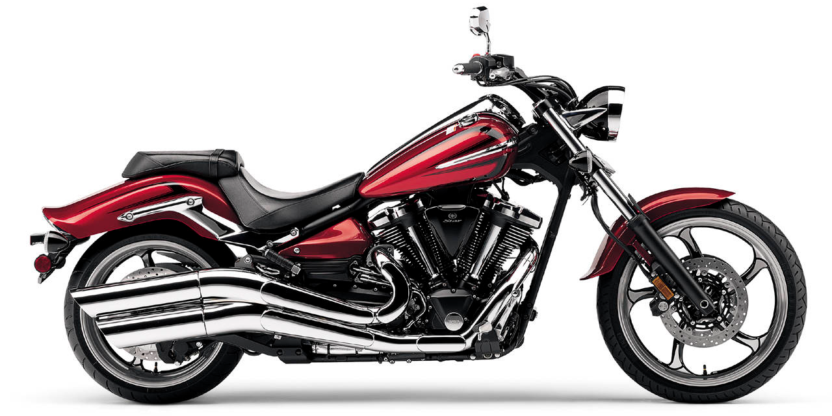
THE WIND IN YOUR FACE
THE DUSTY ROAD
YOUR BIKE
YOU
THE CONNECTION IS DEEP

Slide 3
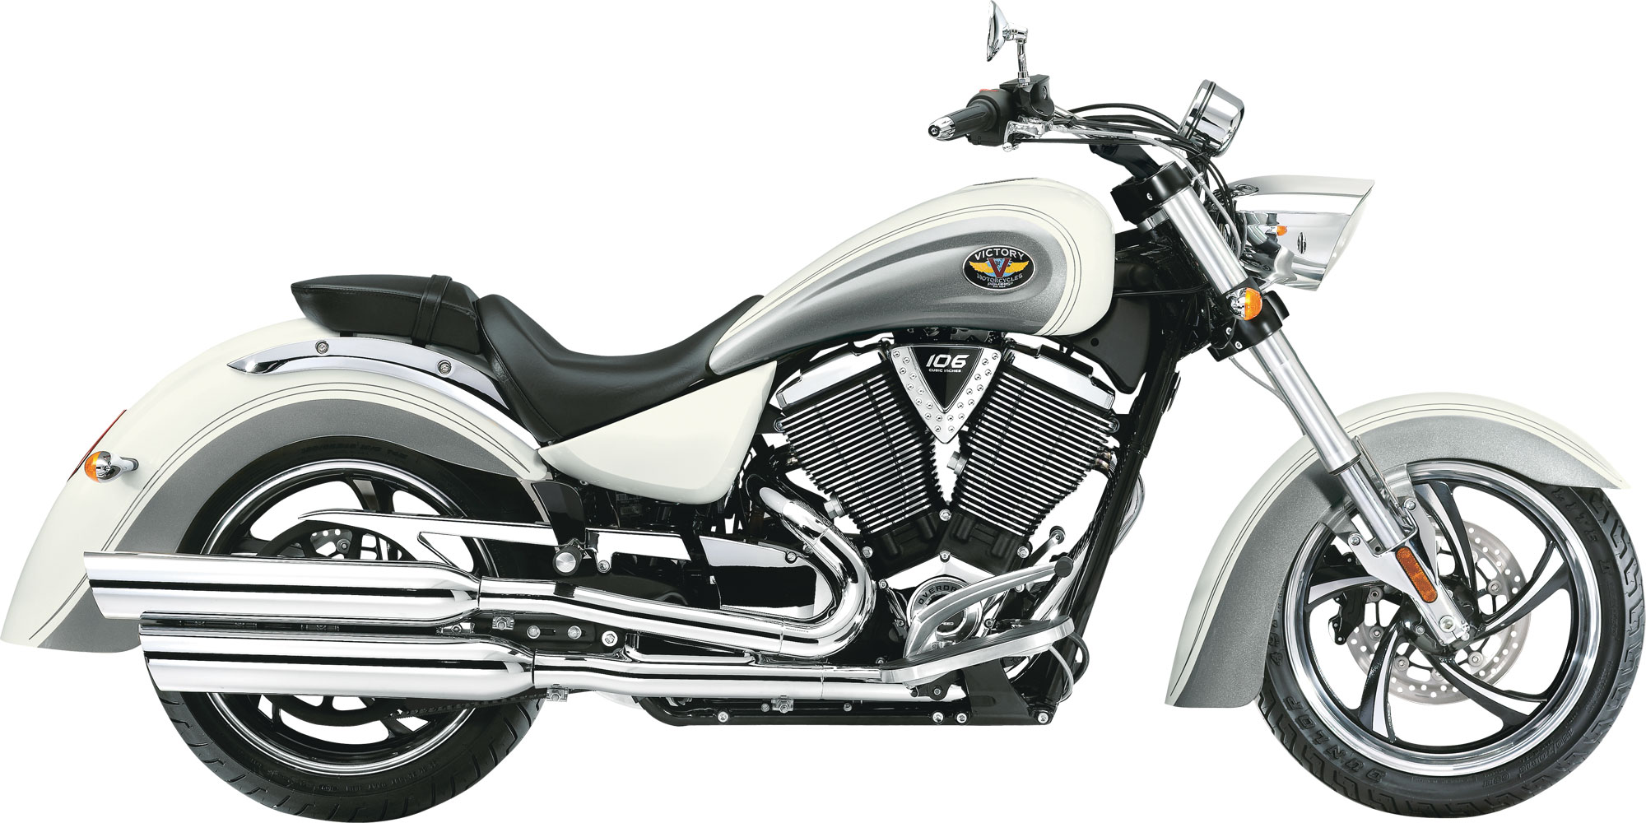
WITH
SMART RIDE
THE CONNECTION IS
TRUE

Slide 4
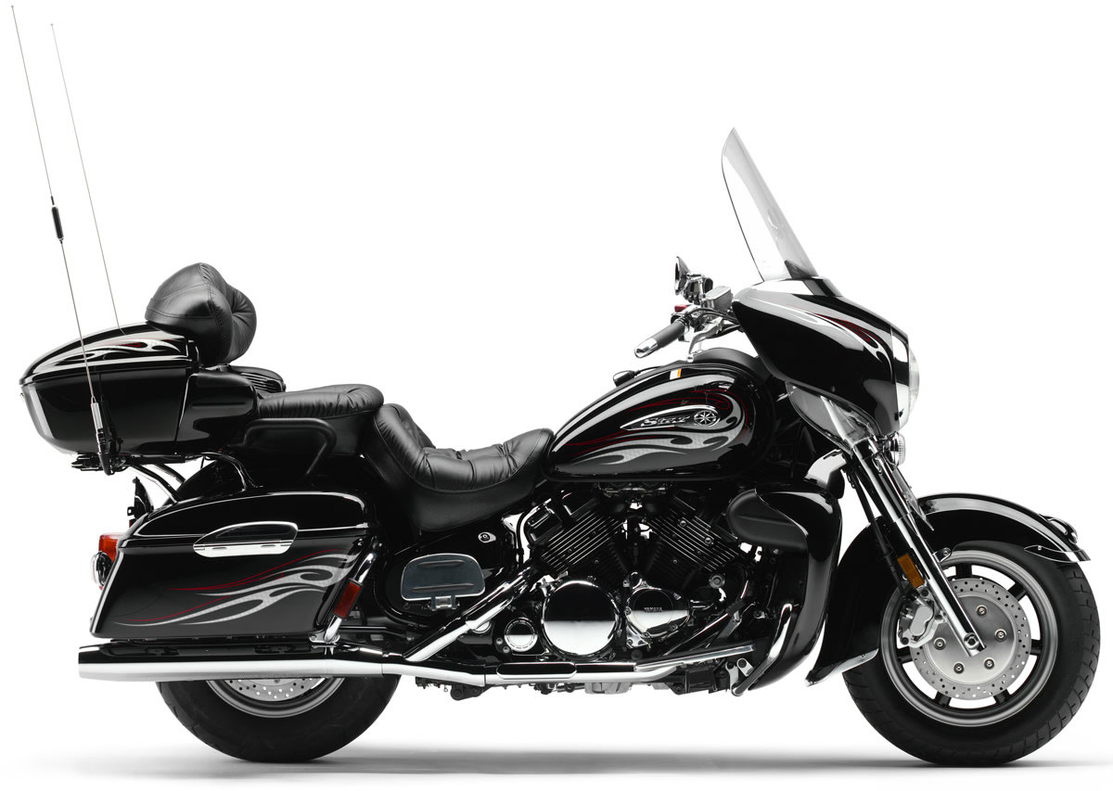
SENSORS: TEMPERATURE, PRESSURE, PROXIMITY, WEIGHT, SPEED, … MOUNTED CAMERA, ACTUATORS, …

Slide 5





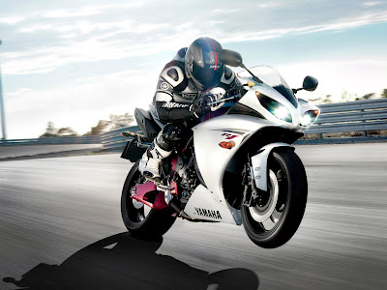


Slide 6
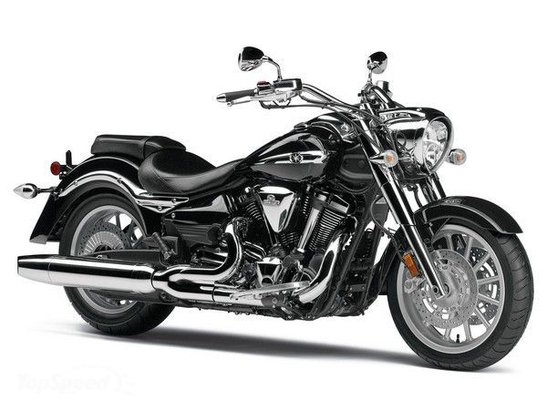

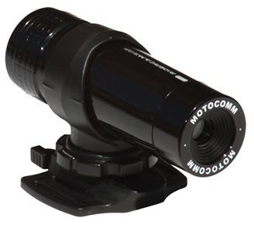
RIDERS GO WHERE OTHERS CAN’T
SMART RIDE MAPS UNCHARTERED TERRAIN

Slide 7
SPONSORED RIDES COLLECTS USAGE INFO

Slide 8
MONITOR RIDING SAFETY

Slide 9

PICK UP ITEMS AT STORES ALONG THE WAY

Slide 10

BIKE PERFORMANCE CORRELATED WITH CLIMATE CONDITIONS

Slide 11

DISCOVER PLACES ALONG THE WAY

Slide 12
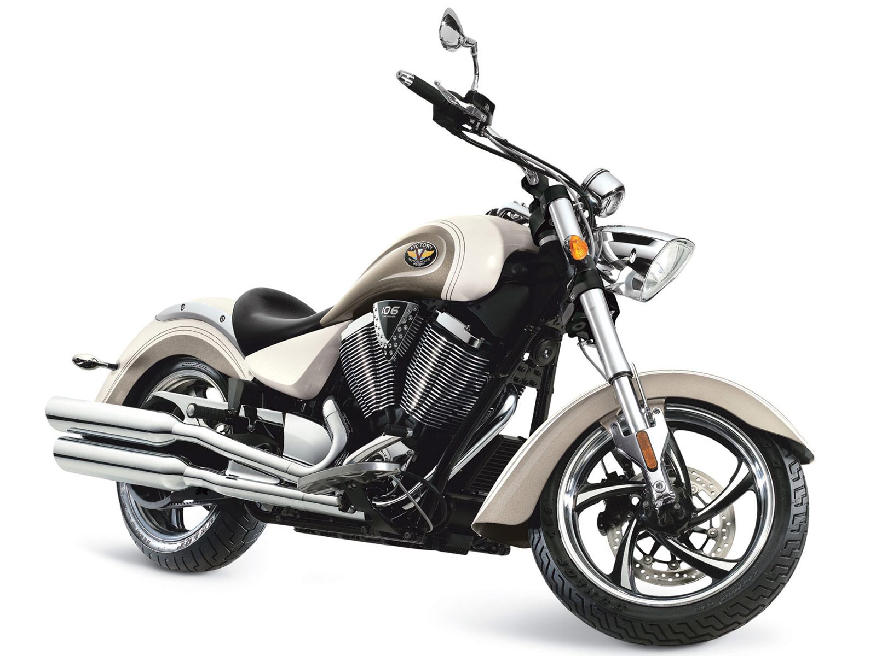
SMART RIDE

